Slide 1


ITM UNIVERSITY, GWALIOR
Development of Minor Project
Under the supervision of Presented By
Mr. Sheo Kumar, Assistant Professor,CSA
Bhawesh Agrawal (BETN1CS20101) Prabhanshu Sisodia (BETN1CS20030) Akul Gupta (BETN1CS20003)
Topic :T-Quiz

Slide 2

Contents
Introduction | 3 |  | Objectives | 7
Functionalities of Project | 4 |  | Expected Outcome | 8-9
Literature survey | 5 |  | Future Scope | 10
Proposed Methodologies | 6 |  | References | 11

Slide 3
Introduction
T-Quiz
The ‘MCQ Quiz Application’ project will be developed to overcome the time consuming problem of manual systems. Apart from that in the current system, checking the answer sheets after taking a test, wastes the examiners time, so this application will check the correct answer and save the examiner time and carry the examination in an effective manner. The users which use this system don’t need high computing knowledge and also the system will inform them while entering invalid data.
The aim of this project is to computerize the existing manual system and help the examiners to save their valuable time and important data. Apart from this, data which exist in this system, will exist for a long period of time and will be easily accessible. This project helps the examiners to manage their services in a good way and provide a better service to their users.

Slide 4
Functionalities of Project
1 | Able the examiners to punch the MCQ questions online
2 | Able the users to solve the questions online
3 | Examiners can manage the information regarding exam
4 | Correct answers will be evaluated by system (First it should be determining by examiner)
5 | Users can see their result after submitting the test.
This involves designing and developing the user interface (UI) and user experience (UX) of the quiz application. The front-end development team is responsible for creating an attractive and user- friendly interface that makes it easy for users to navigate through the application and take quizzes.

Slide 5

Literature Survey
To design and implement this project we plan that the project will support different types of users apart from its administrative part. When a project is run for the first time it allows the user to select who he/she wants to login in the system. Project supports login as teacher and login as student. If a user is a student, try to login as the teacher system will not allow him and vice versa. Users who add as teacher in the system will be able to punch tests and questions to the system and also will be able to observe the result of the student who attempts tests. Users who login to the system as students will be able to select a particular test and attempt questions depending on this test. After attempting the test and submitting that user will receive a message that you have attempted the test successfully and if the user tries to attempt the same test, the system will not allow him/her. Also a user who logs into the system as a student will be able to observe the result of the test he/she attempts.

Slide 6
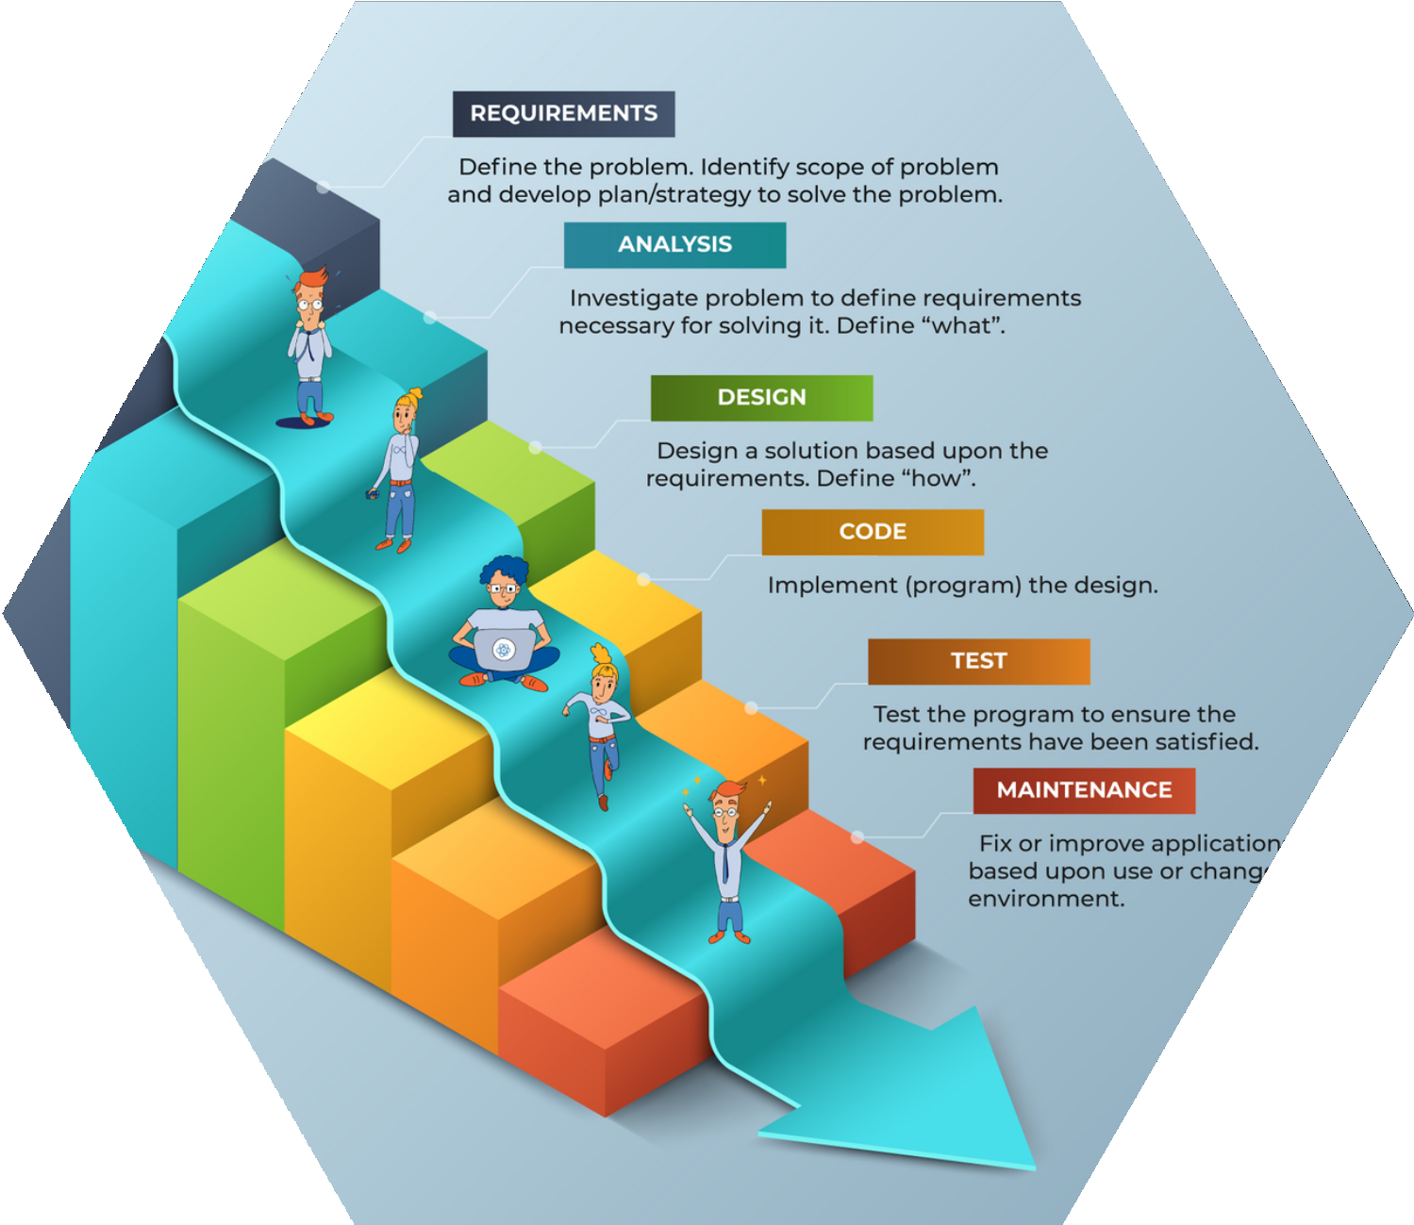
Proposed Methodologies
The methodology of developing this project will be a step-by-step sequence to design, develop and deliver the application. In software engineering this methodology is called the ‘waterfall model’ in which one portion of work follows after another in a linear sequence.

Slide 7
Objectives
To create an appropriate platform for best managing of MCQ test,
To overcome the time consuming issues and taking MCQ tests,
To release the marks of the test taker as soon as possible,
To manage the information of different tests

Slide 8

Expected Outcome
Index
This is the first page which users observe after running the project. This page will enable the user to select the type of login. Selecting “Login as Teacher” will direct the user to the Teacher Login Page and selecting “Login as Student” will direct the user to Student Login
Page.
login Page
Login pages exist for both teachers and students. After the user selects the type of login, the login page of a particular user will be displayed. Users enter their username and password and after clicking on login the first system will check if it is a valid user or not.
Home Page
After users successfully login to the system. Each particular user will be directed to their particular Home Page which are “Teacher Home” and “Student Home”. Teacher Home will enable the teachers to observe information about the Online MCQ Quiz and punch a test by clicking on “Punch Test” and observe student results by clicking on “Student Marks”.

Slide 9

Expected Outcomes
Punch Test
Clicking on the punch test in Teacher Home will direct the teacher to a page which allows the teacher to write the name of the test he/she wants to punch. When the teacher types the name of the test and clicks on “Submit to Questions”, the system will be directed to the Insert Question page. By clicking on the “Submit to Enter Question” button, the teacher
will be able to insert a question for the particular test in which he/she enters its name. As the teacher enters the test name, an automatic ID will be generated for this test in the Test Table of the database and all a session will be created, all questions which are entered will be store for the particular test according to Test ID and session which has been created. Teacher will receive 8 of “Question Successfully Stored” each time when he/she write the questions and its answer and clicks on “Submit Question” button.
Attempt test
Clicking on “Attempt Test” on Student Home will direct the student to the page which enables the student to select the test he/she wishes to attempt.

Slide 10


Future Scope
As mentioned the project is on a Java platform which is coded in NetBeans IDE with the help of HTML, CSS and JavaScript and running as a web page by Apache Tomcat web server. But this project is only for MCQ tests but in the future we have plans to extend it to support subjective type of questions with more functionality. We will add an Administrative part on it which enables the system to delete tests, add users, delete users and so on graphically via the web.
To conclude, this is a simple Online MCQ Quiz which enables a teacher to punch MCQ questions to a system which will be stored in SQL Server database and able the student to attempt any test for once. The marks of students will be calculated according to questions they attempt and will be displayed by the system to teachers and students.

Slide 11
References
A
https://docs.oracle.com/javase/tutorial
B
http://www.javaworld.com/javaworld/jw-01-1998/jw-01-credentialreveiw.htm
C
https://www.tutorialspoint.com/java
D
http://www.javapoint.com/java-tutorial

